Slide 1
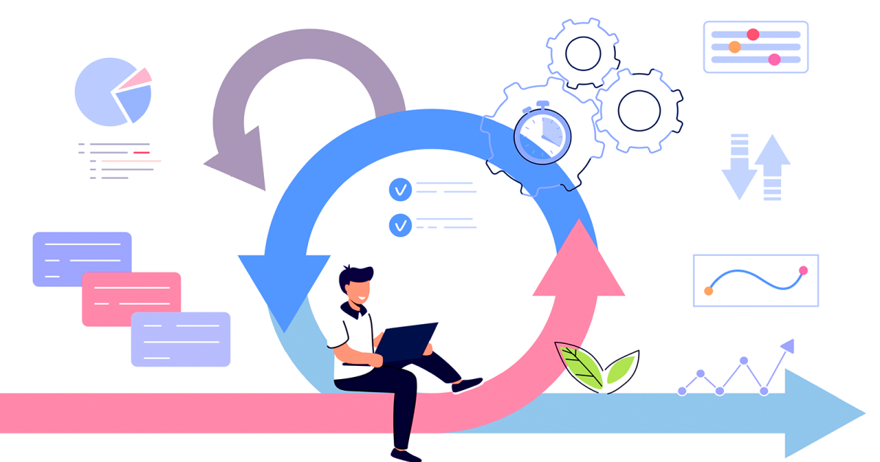

Agile Software Development
Name : Kishore.K
This presentation provides an overview of Agile software development. Learn about Agile principles, values, and the development process. Understand the advantages and disadvantages of using Agile. Discover how Agile can improve team collaboration and deliver value.
By Kishore. K
by Sri vimal

Slide 2
Agile at a Glance
Iterative Approach
Core Values
Agile is iterative and incremental. It emphasizes collaboration and adaptability. It focuses on customer satisfaction.
Individuals and interactions.
Working software.
Customer collaboration.
Responding to change.

Slide 3

Why Use Agile?
Team Empowerment
Tangible Value
Agile encourages team positivity. It empowers self-organizing teams.
Agile delivers tangible value early. It focuses on value-added tasks.
Quick Response
Agile enables quick response to change. It promotes transparency via demos.

Slide 4
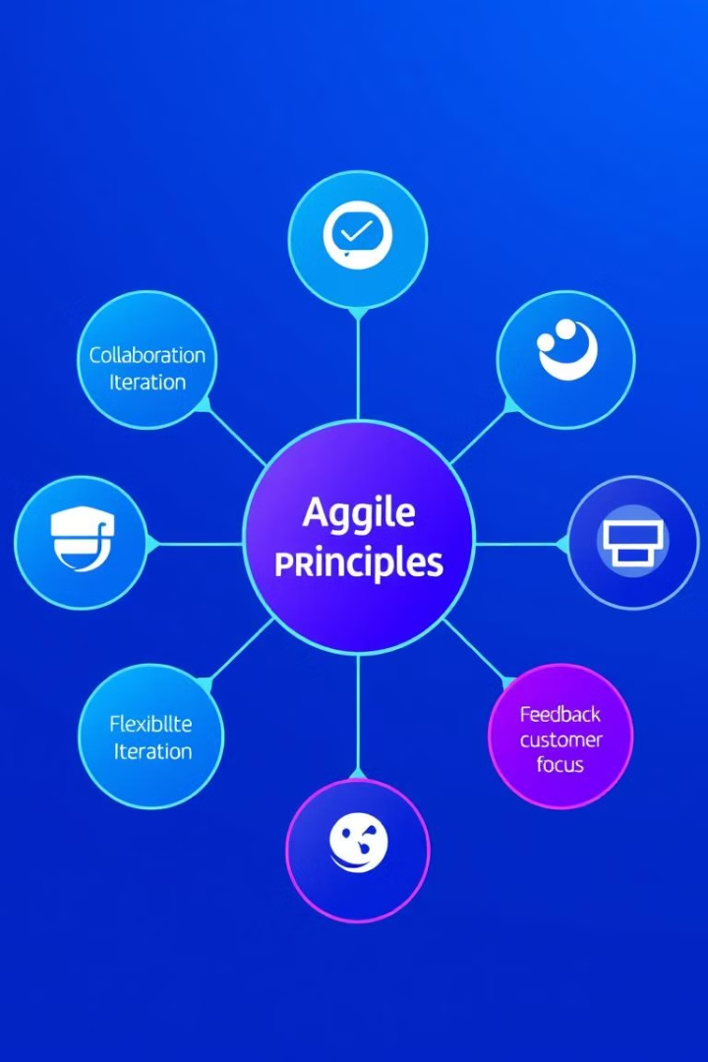
12 Agile Principles
1
Customer Satisfaction
Early and continuous delivery for satisfaction.
2
Embrace Change
Embrace changing requirements. Welcome alterations.
3
Motivated Individuals
Build projects around motivated individuals.
4
Face-to-Face
Face-to-face communication is best. Working software is progress.

Slide 5





Agile Development Process
Planning
Define project scope and goals.
Development
Build software in short cycles.
Testing
Ensure quality and functionality.
Deployment
Release working version.
Maintenance
Support and update software.

Slide 6





Agile Cycle
Inception
Concept
2
Team setup, planning.
1
Identify opportunity.
Iteration
3
Build software.
5
Production
Support software.
4
Release
Deliver version.
The Agile cycle ensures iterative development and continuous improvement. Each stage contributes to a working, valuable product. Regular feedback drives future iterations.

Slide 7
Agile: Advantages & Disadvantages
Advantages
Disadvantages
Faster delivery & trust.
Difficult estimation.
Quick response to change.
Less documentation.
Continuous feedback.
Dependent on input.
Emphasis on people.
Communication issues.
Improved collaboration.
Risk of scope creep.

Slide 8

Thank You!

